Slide 1
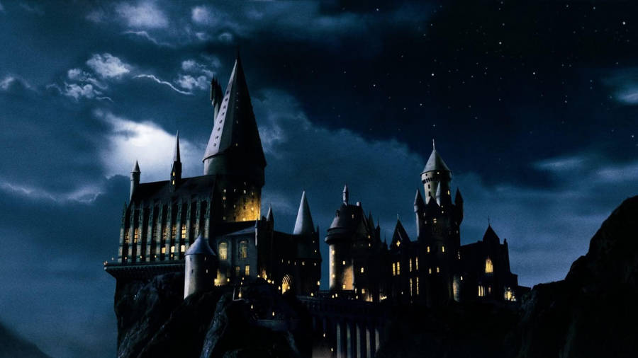
STOP PRESS
THE DAILY PROPHET
For A Wizarding World That Won’t Stop Talking
FELIX FELICIS VANISHES FROM HOGWARTS
11:47 PM — FIRST NEWS IN
Notes:
Read the STOP PRESS headline aloud, in character, as the room settles — like breaking news just came over the wire. Don't explain the exercise; just start reporting.

Slide 2
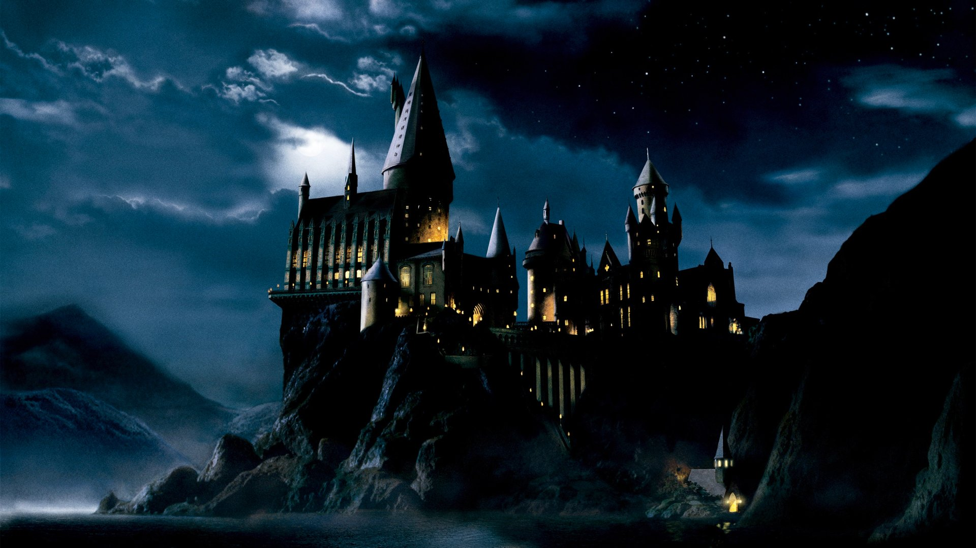
THE DAILY PROPHET
FIRST EDITION — 11:52 PM
Snape’s Stores Breached on Eve of Final
By Rita Skeeter, Senior Correspondent
A vial of Felix Felicis has vanished from Snape’s private stores — sometime after eleven o’clock, hours before the Quidditch final.
The cabinet was opened with a simple charm. Not forced. Someone who knew the room.
No arrests yet. This reporter is just getting started.
No. 1 — The Vanishing of the Felix Felicis
Notes:
Read this as the opening article — full Rita Skeeter drama. This is scene-setting only; nothing here should be treated as a puzzle yet.

Slide 3
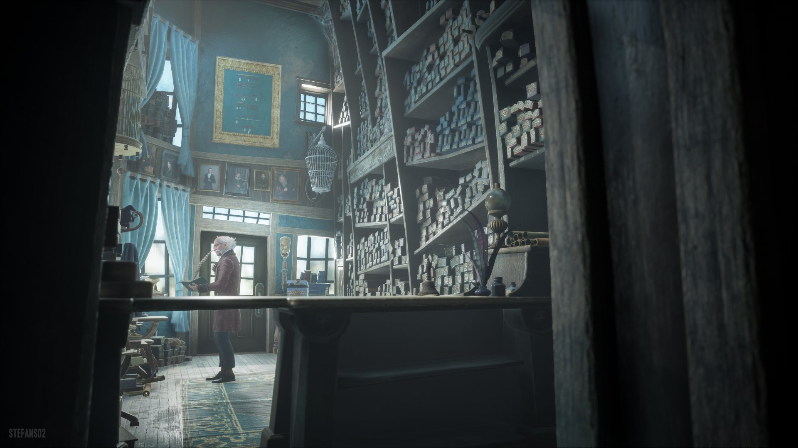
THE DAILY PROPHET
STOP PRESS — 12:05 AM
A Strange Delivery
1
ENCLOSED WITH THIS EDITION — EXHIBIT 1: THE ANONYMOUS VERSE
An owl rapped at the newsroom window tonight. No note, only a verse, in a hand nobody here recognises.
Our own cryptographers are stumped. Perhaps our readers will do better.
Notes:
CUE: Hand out Exhibit 1 — The Anonymous Verse — to every team now. Do not explain that it's a Caesar cipher or hint at the shift. Let them discover it needs decoding and figure out how.

Slide 4
5:00
NEXT EDITION ROLLS IN
The presses wait for no one.
No. 3 — The Vanishing of the Felix Felicis
Notes:
Wait ~5 minutes here. Teams should be pasting the verse into their AI chat tool and working out what kind of cipher it is. If a team asks for a hint, tell them nothing yet — this is meant to take real back-and-forth with the AI, not a single lucky guess.

Slide 5

THE DAILY PROPHET
SECOND EDITION — 12:20 AM
Names on Every Tongue
By Rita Skeeter, Senior Correspondent
By breakfast, four names were already being traded like Chocolate Frog cards:
Rosalind Hex — furious at Snape, absent from dinner.
Cassian Vane — patrolling that very corridor that night.
Oswin Bramblewick — caught out of bed, not far from the scene.
Marigold Thistlewood — plays for the Cup today — says she doesn’t care who wins.
No. 4 — The Vanishing of the Felix Felicis
Notes:
No handout for this edition — it's scene-setting only. Give teams a moment to note the four names before moving on; they'll want to feed these into their AI chat as context.

Slide 6
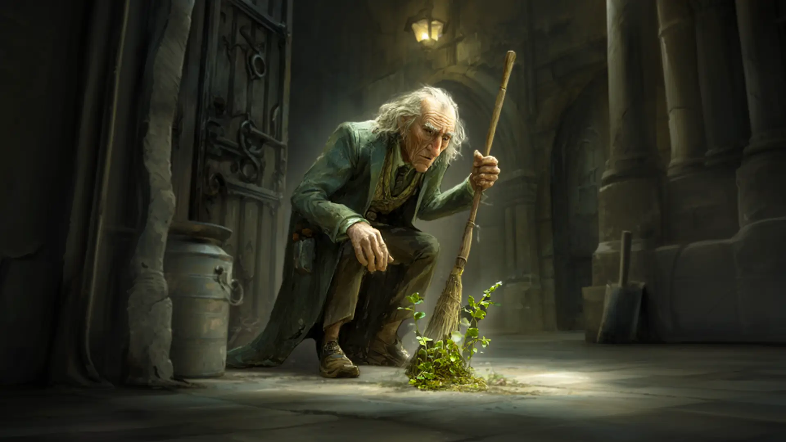
THE DAILY PROPHET
THIRD EDITION — 12:45 AM
What Filch Found
2
ENCLOSED WITH THIS EDITION — EXHIBIT 2: FILCH’S CONFISCATION LOG
Our caretaker logs every curiosity confiscated in this castle. The night of the theft was no exception.
One entry stands out: a torn scrap of parchment, found on the dungeon floor. Nobody has claimed it.
No. 5 — The Vanishing of the Felix Felicis
Notes:
CUE: Hand out Exhibit 2 — Filch's Confiscation & Incident Log — to every team now.

Slide 7
4:00
NEXT EDITION ROLLS IN
No. 6 — The Vanishing of the Felix Felicis
Notes:
Wait ~4 minutes. Teams should be cross-referencing the log against the suspects and asking their AI what the unclaimed parchment scrap might mean.

Slide 8
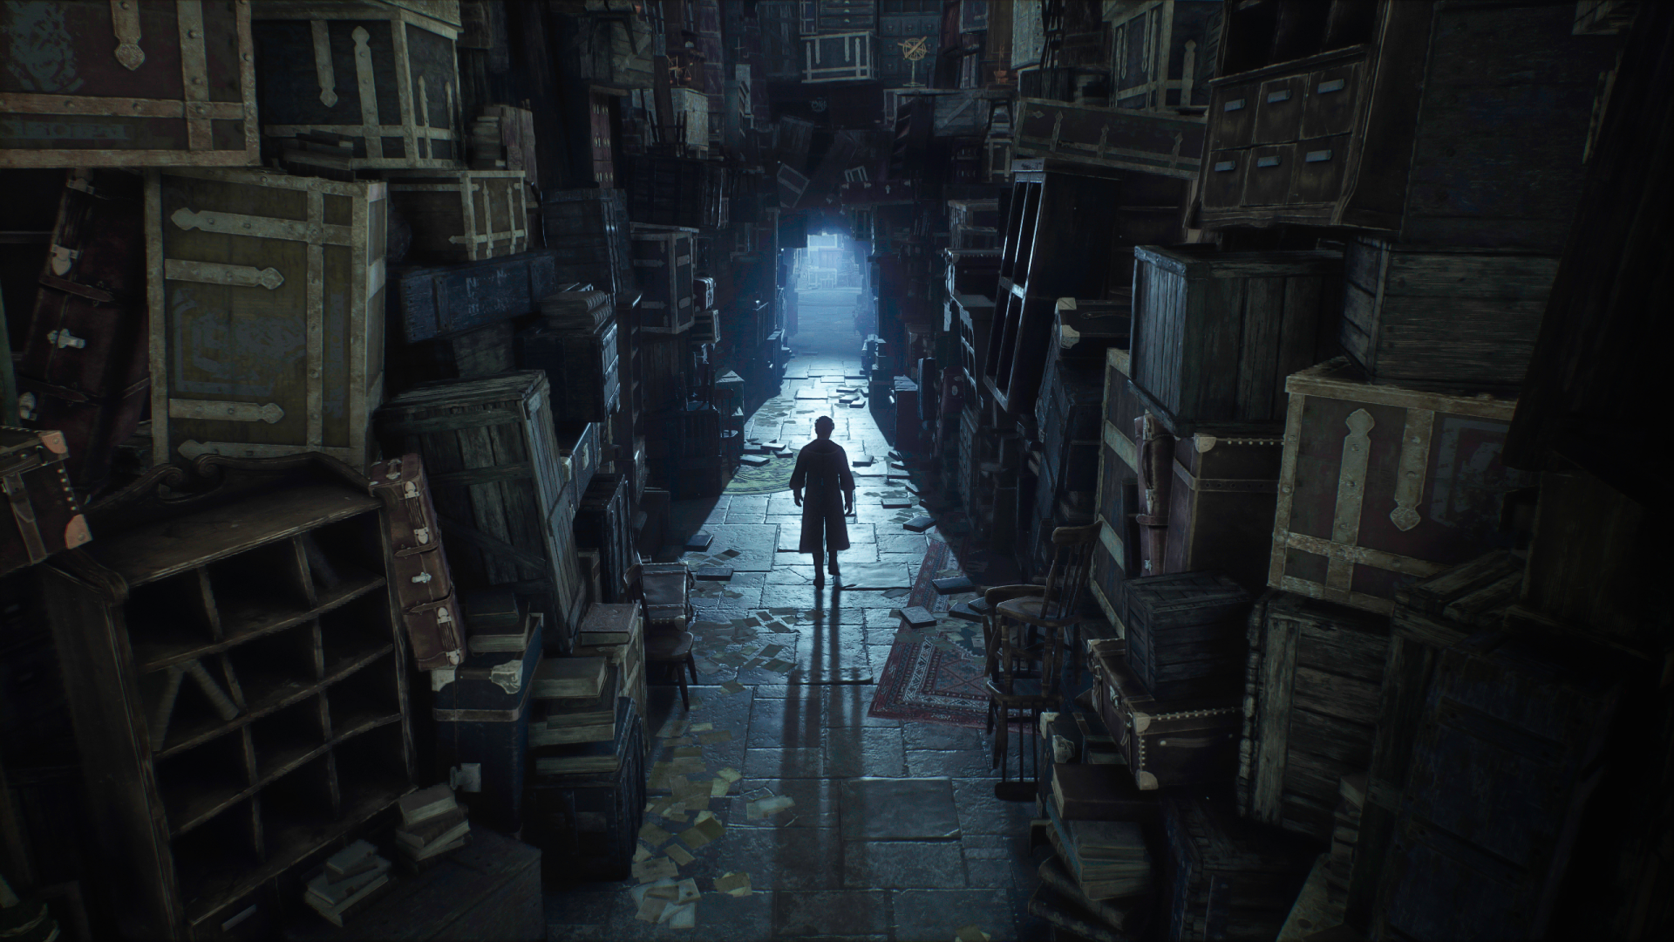
THE DAILY PROPHET
FOURTH EDITION — 1:10 AM
Who Walked the Dungeon Halls
3
ENCLOSED WITH THIS EDITION — EXHIBIT 3: PATROL ROSTER & SIGN-OUT SHEET
Every corridor is meant to be walked by a prefect after dark.
The official roster and the gate log don’t quite tell the same story.
No. 7 — The Vanishing of the Felix Felicis
Notes:
CUE: Hand out Exhibit 3 — Patrol Roster & Sign-Out Sheet. This is the timeline clue — don't point out the contradiction, let a team notice the roster and the sign-out sheet don't agree.

Slide 9
4:00
NEXT EDITION ROLLS IN
No. 8 — The Vanishing of the Felix Felicis
Notes:
Wait ~4 minutes. Teams should be checking the roster against the sign-out sheet and asking their AI whether the timeline holds up for each suspect.

Slide 10
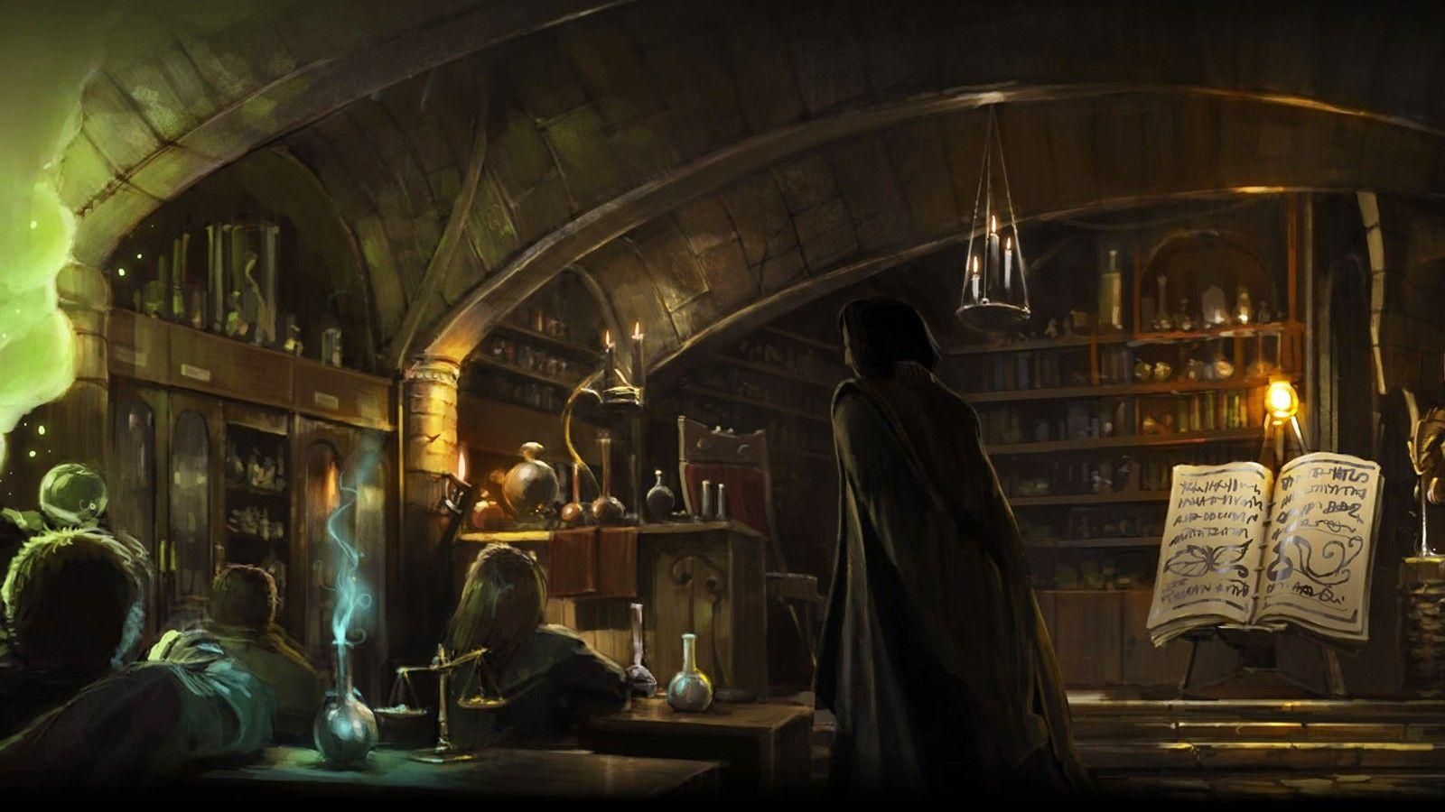
THE DAILY PROPHET
FIFTH EDITION — 1:35 AM
The Healer’s Book, the Potions Shelf
4
ENCLOSED WITH THIS EDITION — EXHIBIT 4: HOSPITAL & POTIONS LEDGERS
Two ledgers reached this desk tonight, the Hospital Wing’s, and the potions store’s.
One name is cleared. Another raises questions.
No. 9 — The Vanishing of the Felix Felicis
Notes:
CUE: Hand out Exhibit 4 — Hospital Wing & Potions Withdrawal Ledgers. Some sharp teams may start naming a culprit after this one — that's expected and fine, don't confirm or deny.

Slide 11
4:00
NEXT EDITION ROLLS IN
No. 10 — The Vanishing of the Felix Felicis
Notes:
Wait ~4 minutes. By now most teams should have a leading suspect but may not yet be fully certain — that's intentional.

Slide 12
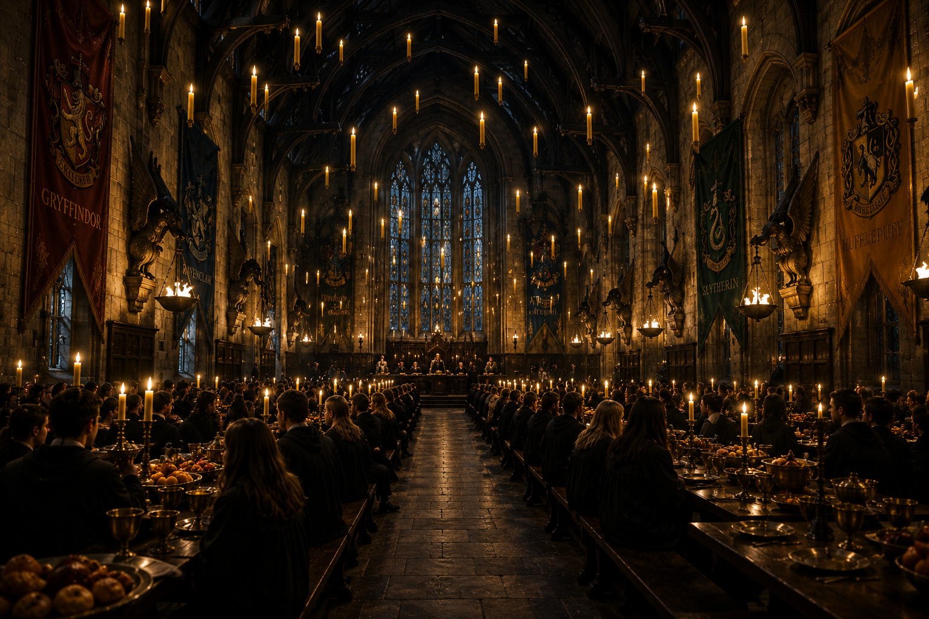

THE DAILY PROPHET
FINAL EDITION — 2:00 AM
A Letter Meant to Burn
5
ENCLOSED WITH THIS EDITION — EXHIBIT 5: THE INTERCEPTED LETTER
A letter has reached this desk, recovered from a returned library book. Its top right corner is torn away.
This reporter need hardly remind readers of the unclaimed scrap Filch found that very night.
No. 11 — The Vanishing of the Felix Felicis
Notes:
CUE: Hand out Exhibit 5 — The Intercepted Letter. This is the last piece of evidence. Everything a team needs to name the culprit with full confidence — means, opportunity, motive, and matching physical evidence — is now in the room.

Slide 13
5:00
FINAL EDITION ROLLS IN
Name your culprit — and the evidence that proves it.
No. 12 — The Vanishing of the Felix Felicis
Notes:
Final working window, ~5 minutes. When time is up, go around the room and have each team state a name and their strongest piece of evidence before you reveal the closing edition. Don't confirm or deny until every team has answered.

Slide 14
THE DAILY PROPHET
LATE FINAL — 5:58 AM
Thistlewood Taken In for Questioning
By Rita Skeeter, Senior Correspondent
Marigold Thistlewood was taken in before dawn. An empty vial was found in her trunk.
Ingredients withdrawn under a reason that never held up. A corridor left unwatched from 10:47 that night. A letter, half in code, confessing a need for luck that had nothing to do with a House Cup. And a torn corner that fit exactly.
The presses, at last, can rest.
No. 13 — The Vanishing of the Felix Felicis
Notes:
Read this as the closing edition — the full reveal, in character. Once finished, drop out of character and debrief conversationally: which piece of evidence actually convinced each team, and at what point their AI conversation turned from reading to reasoning. No slide needed for this part.

